Slide 1
FLIPROBO TECNOLOGIES USED CAR PRICE PREDICTION
SUBMITTED BY :-
TANUJ SWARNKAR

Slide 2
INTRODUCTION
Even before coronavirus had paralysed the country, personal mobility had become vital to people in India.
Urbanisation and connectivity had a significant effect on the way we perceived cars, creating a niche in the market for used cars.
Today, with a population of 136.64 Cr, India pushes approximately 2.9 million used cars into the market annually.

Slide 3
ABSTRACT
Due to pandemic situation in (2019 to 2021), we have seen abundant changes in the car sales. Now some cars are in demand hence making them costly and some are not in demand hence cheaper.
One of our clients works with small traders, who sell used cars. With the change in market due to covid 19 impact, our client is facing problems with their previous car price valuation machine learning models.
To build a model, which is used to predict car price using features like km driven, Num_of_owner, year, Transmission, etc.

Slide 4
DATA PREPROCESSING
HANDLING NULL VALUES & DUPLICATE COLUMNS
IDENTIFY &REMOVE OUTLIERS
DROPPING INAPPROPRIATE COLUMNS
LABEL ENCODING
FEATURE SCALING

Slide 5
HANDLING NULL VALUES
The features Fuel, Driven_kilometers, Num_of_owners, Transmission and Price1 having null values
The features Transmission, Location having null values so I have used mode value to replace null value. The features having null values are string type so I have replaced with mode value

Slide 6
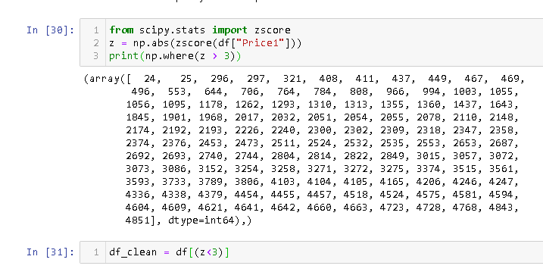
IDENTIFY & REMOVE OUTLIERS
Outliers are identified and removed using zscore
After using zscore the data loss is 2.14%

Slide 7
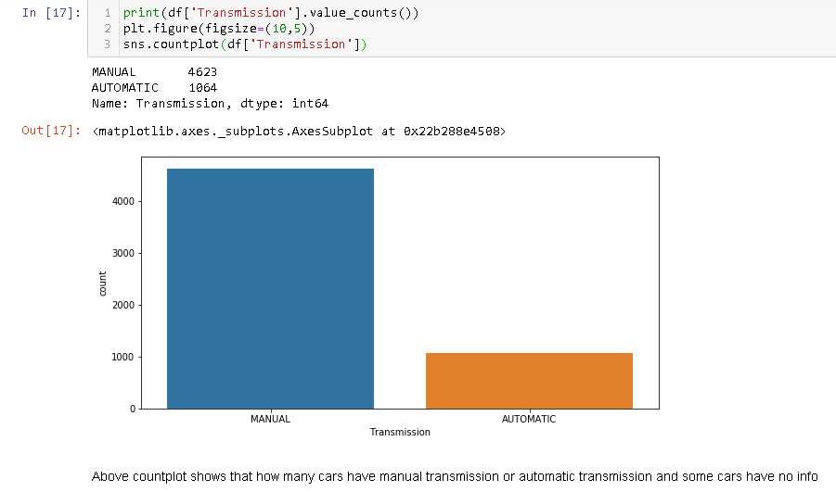
VISUALIZATION

Slide 8
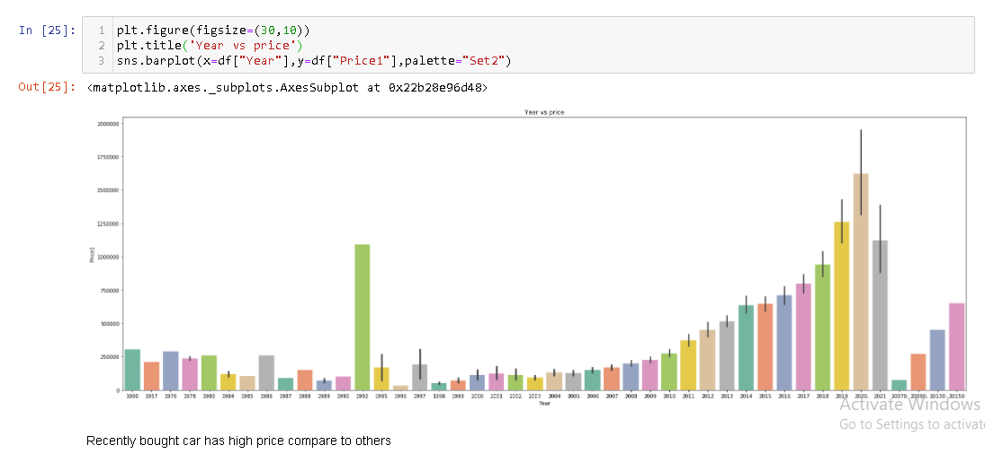
VISUALIZATION
Recently bought cars has the high price compare to others

Slide 9
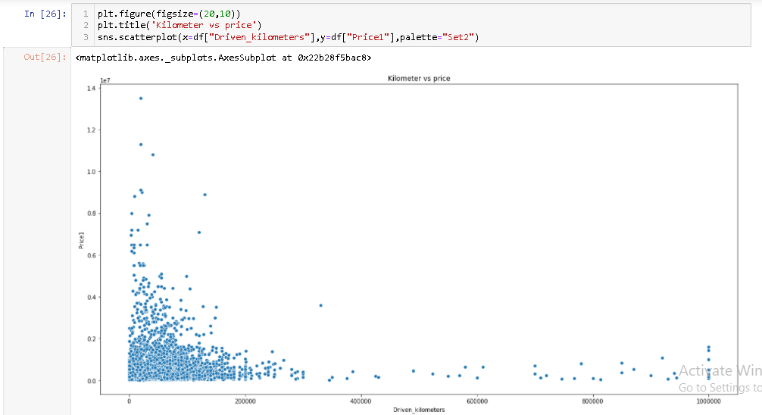
KILOMETERS DRIVEN VS PRICE
The cars which has less kilometers driven has high value in the market

Slide 10
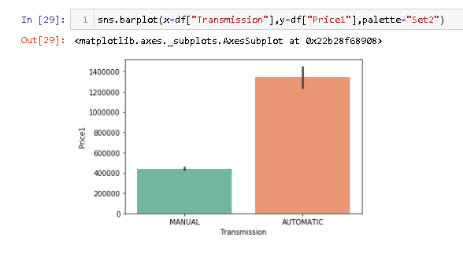
TRANSMISSION VS PRICE
Automatic cars are pricey when compare to manual

Slide 11
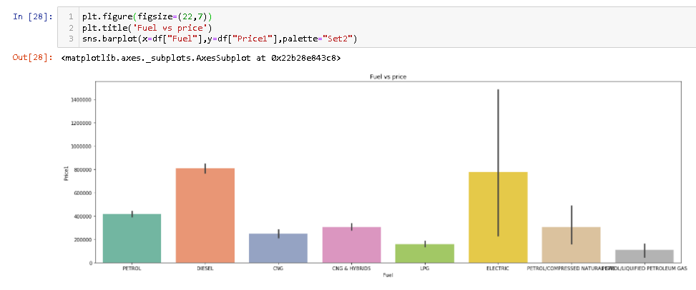
FUEL VS PRICE
Diesel cars and electric cars are high pricey than other fuel emissioned cars

Slide 12
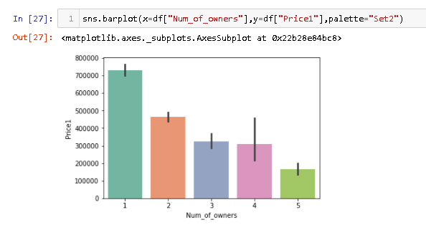
OWNER VS PRICE
If the car is from first owner it has high value

Slide 13
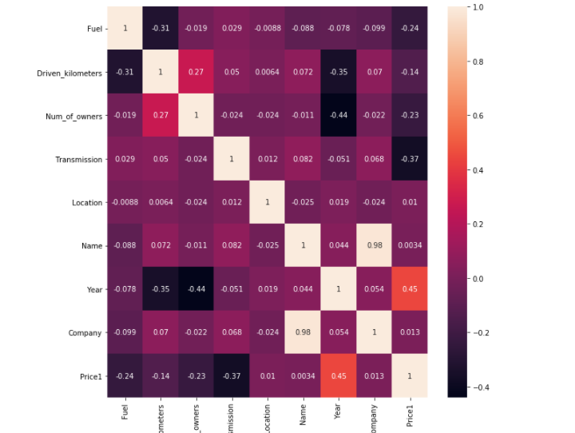
CORRELATION MATRIX
Transmission is negatively correlated to price
Year is negatively correlated to Num_of_owner
year is positively correlated to price

Slide 14
LABEL ENCODING
Label Encoder can be used to normalize labels
converting the categorical data into a numeric data using label encoding technique

Slide 15
FEATURE SCALING
Transforming un scaled data to scaled data using Min max scalar
MinMaxScaler subtracts the minimum value in the feature and then divides by the range. The range is the difference between the original maximum and original minimum.

Slide 16
INTERPRETATION OF DATA
Most of the owners are first owner
Most of the cars are manual car
Almost equal number of petrol and diesel cars are available
Recently bought car has high price compare to others
The cars which has less kilometres driven has high value in the market
Diesel cars are high pricey than petrol cars

Slide 17
INTERPRETATION OF DATA
New car is more pricey than old car. In the plot it is apparent that price is positively correlated with year data. In the above representation more points are near to best fit line.
Transmission is negatively correlated with price it means less number automatic cars available in market but its costlier than manual car

Slide 18
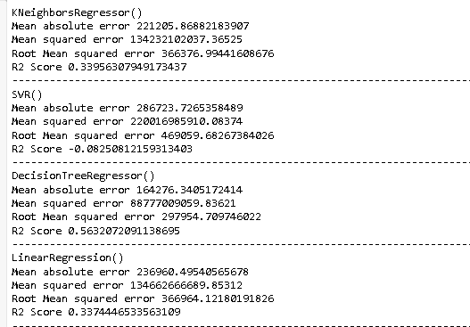
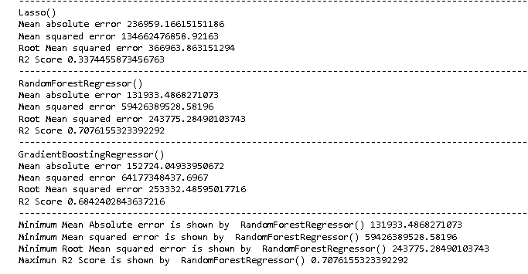
MODEL VS ACCURACY
RandomForestRegressor has high accuracy 70.7%

Slide 19
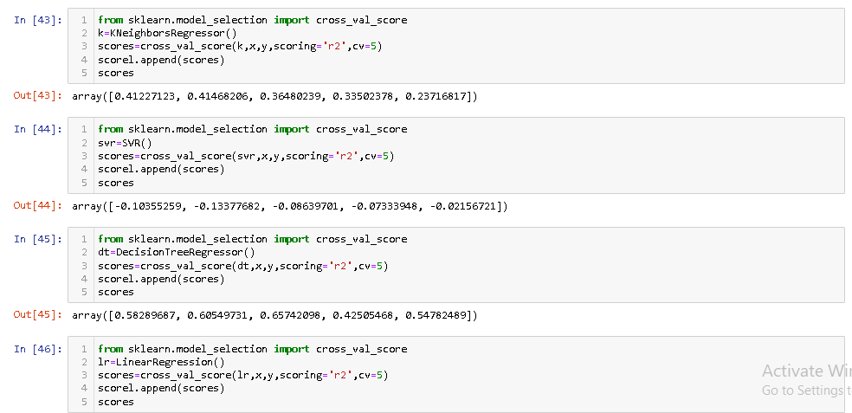
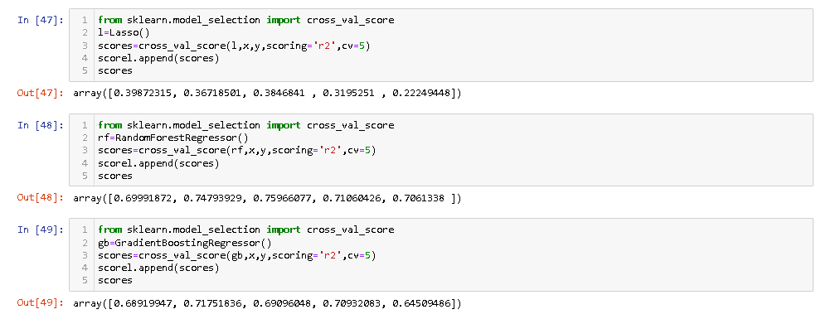
PREDICTED MODEL VS CV
RandomForestRegressor has least difference

Slide 20
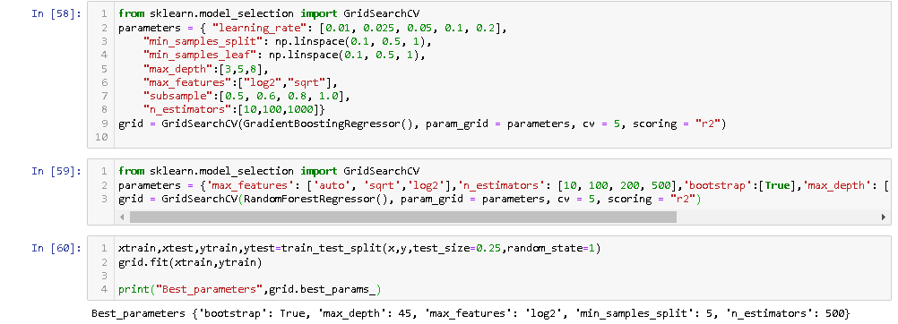
HYPER PARAMETER TUNING
Hyper parameter tuning with best parameter to get the best result and accuracy

Slide 21
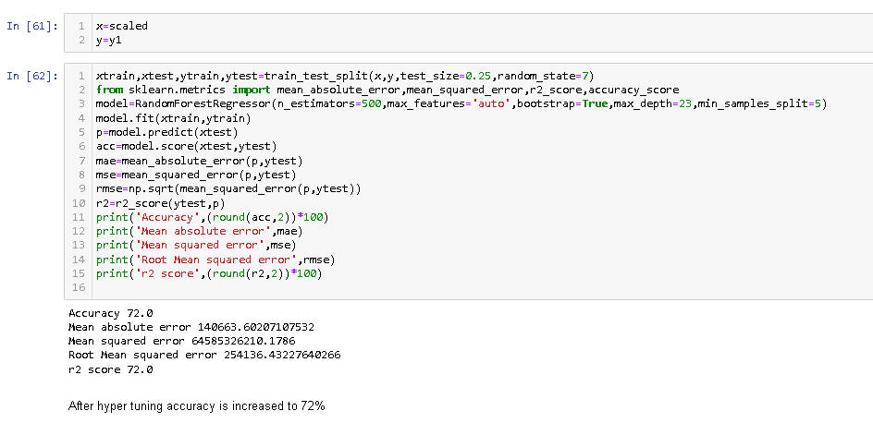
HYPER PARAMETER TUNING

Slide 22
CONCLUSION
According to the interpretation and modelling RandomForest Regressor is best model
Before hyper tuning the model predicted with accuracy 70.7% Best parameters are {‘bootstrap’: True, ‘max_depth’: 45, ‘max_features’: ‘log2’, ‘min_samples_split’: 5, ‘n_estimators’: 500}
After hyper tuning the model predicted with accuracy is 73%

Slide 23
Thank you

